Slide 1


Presentation Guideline
The Colour Group
Set out here are some recommended points of colour, style, layout and so on to help make your presentation as clear as possible, even to the very back row of audience
You can use the slides of this presentation as a guide or template for your own work
The over riding principle must be to keep things clear, simple and rather plain
In matters of presentation style and layout, remember:
LESS IS MORE
(Great Britain)
Presentation Guide
Fred Farnsbarns
Institute of Advanced Stuff
Basin Street, London
January 2055

Slide 2
Presentation Guideline
Set out here are some recommended points of colour, style, layout and so on to help make your presentation as clear as possible, even to the very back row of the audience
You can use the slides of this presentation as a guide or template for your own work
The over riding principle must be to keep things clear, simple and perhaps rather plain
In matters of presentation style and layout, remember:
LESS IS MORE

Slide 3
Presentation Guideline
For slides, the most legible typefaces have no serifs
We recommend ARIAL or similar
Font size: no smaller than this 26 point - keep size consistent
If you cannot get all you want to say on the slide except by using a smaller font size, you should redesign what you wish to say, use another slide or consider using handouts
italics, bold and BLOCK CAPITALS are good for emphasis
for easy reading, align text to the LEFT

Slide 4
Presentation Guideline
If you have several points to make, a bullet list like this is clear
A bullet list can have numbered points if you wish
Or you can use letters or even Roman numerals
You can turn off the bullets and have simple items like this
And in this case it is not quite so clear you have a list of points
But turned on again, the bullets help
And your audience sees that you have steps or way-points
For clarity, vertically separate the points of the list
If the separation is too small the effect is cramped like this and suggests poor planning on your part

Slide 5
Presentation Guideline
Try to keep your text blocks on all slides aligned horizontally the same so that as one slide changes to the next the text does not “flick” sideways
Vertical alignment is also good, at least for the top of the text block, but may vary at the bottom as each slide may have different numbers of lines
Once you have a layout you are satisfied with, you can 'copy' and 'paste' the slide to produce multiple slides each with the format you want
You then simply delete the old material and type in the new and the overall appearance of your slides is consistent

Slide 6
Presentation Guideline
Keep slide transitions simple - resist elaborate effects
Simple wipes, pushes or just 'no effect' for a simple replacement work best
By using several slides, an individual point can be highlighted while you talk about it, as below:
Point one
Point two
Point three
Point four

Slide 7
Presentation Guideline
Keep slide transitions simple - resist elaborate effects
Simple wipes, pushes or just 'no effect' for a simple replacement work best
By using fade-in and fade-out and several slides, an individual point can be highlighted while you talk about it, as below:
Point one
Point two
Point three
Point four

Slide 8
Presentation Guideline
Keep slide transitions simple - resist elaborate effects
Simple wipes, pushes or just 'no effect' for a simple replacement work best
By using fade-in and fade-out and several slides, an individual point can be highlighted while you talk about it, as below:
Point one
Point two
Point three
Point four

Slide 9
Presentation Guideline
Keep slide transitions simple - resist elaborate effects
Simple wipes, pushes or just 'no effect' for a simple replacement work best
By using fade-in and fade-out and several slides, an individual point can be highlighted while you talk about it, as below:
Point one
Point two
Point three
Point four

Slide 10
Presentation Guideline
Keep slide transitions simple - resist elaborate effects
Simple wipes, pushes or just 'no effect' for a simple replacement work best
By using fade-in and fade-out and several slides, an individual point can be highlighted while you talk about it, as below:
Point one
Point two
Point three
Point four

Slide 11
Presentation Guideline
For your colour palette, consider the points in the Colour Group advice on colours for those with colour vision deficiencies: https://www.colour.org.uk/guidance-to-speakers/
You will therefore be considerate of how text and graphics are visible on their backgrounds
Except in diagrams and illustrations don't use too many colours from your palette
Avoid highly coloured or textured backgrounds such as those that are often offered as “good examples” by presentation software
And a photo of your institution as a background is usually a mistake, except possibly on the title slide

Slide 12
Presentation Guideline
Use contrasting colours where appropriate
Use contrasting colours where appropriate
Use contrasting colours where appropriate
Use contrasting colours where appropriate

Slide 13
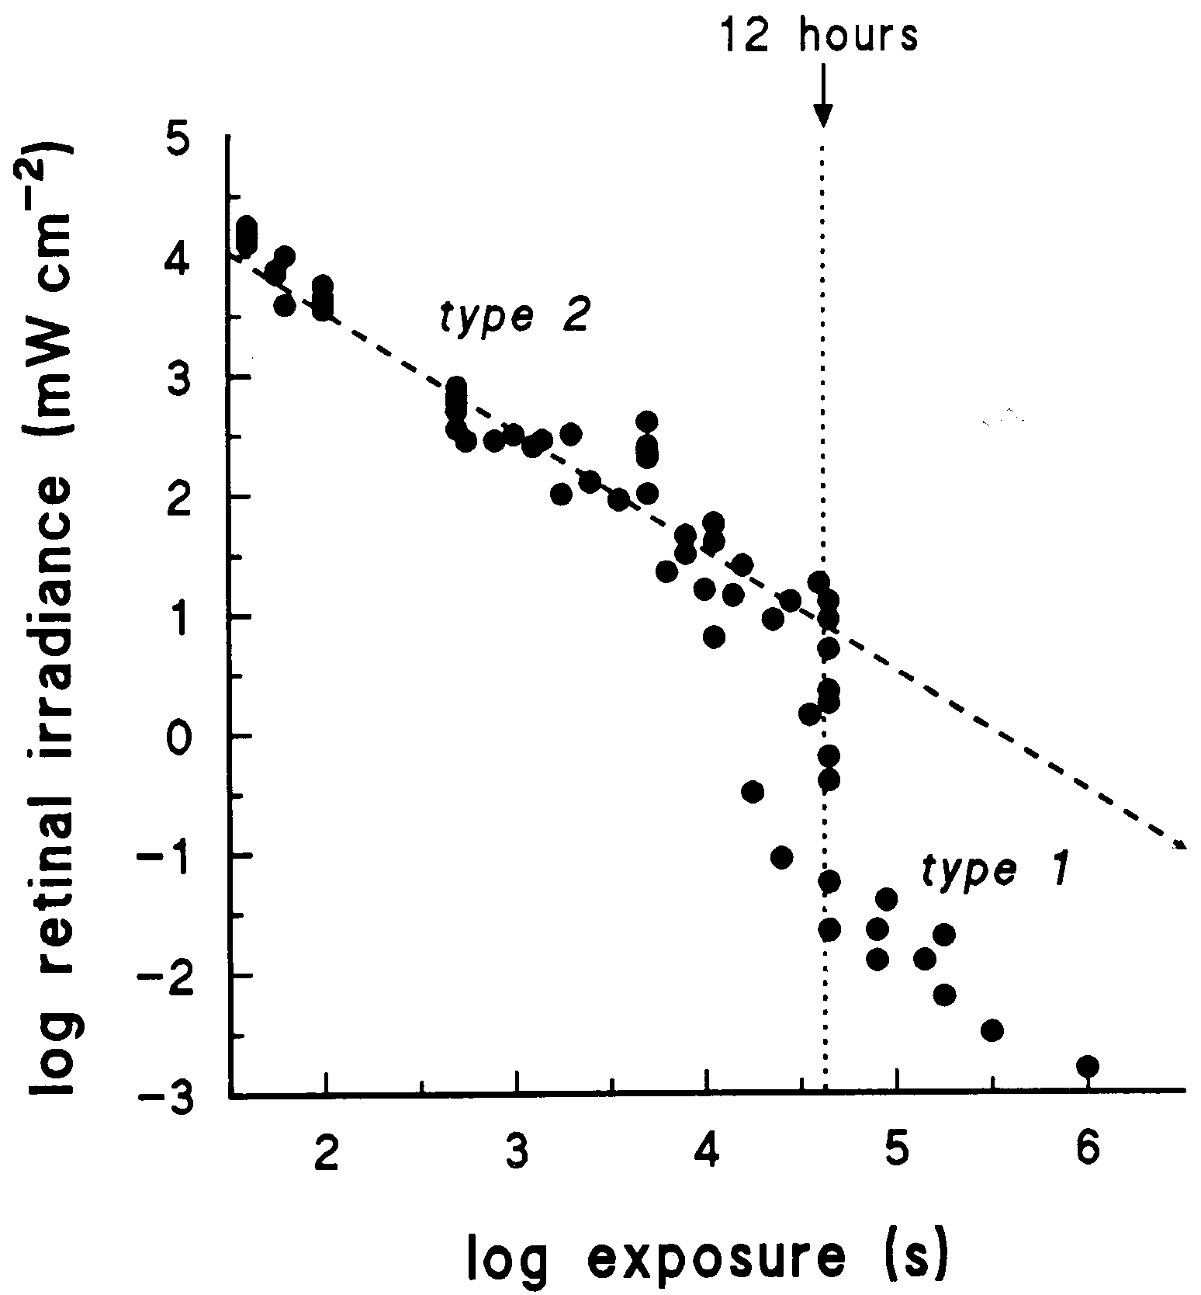
Presentation
Guideline
Keep figures large and clear: which is best for the back row of the audience, this slide or the next?

Slide 14
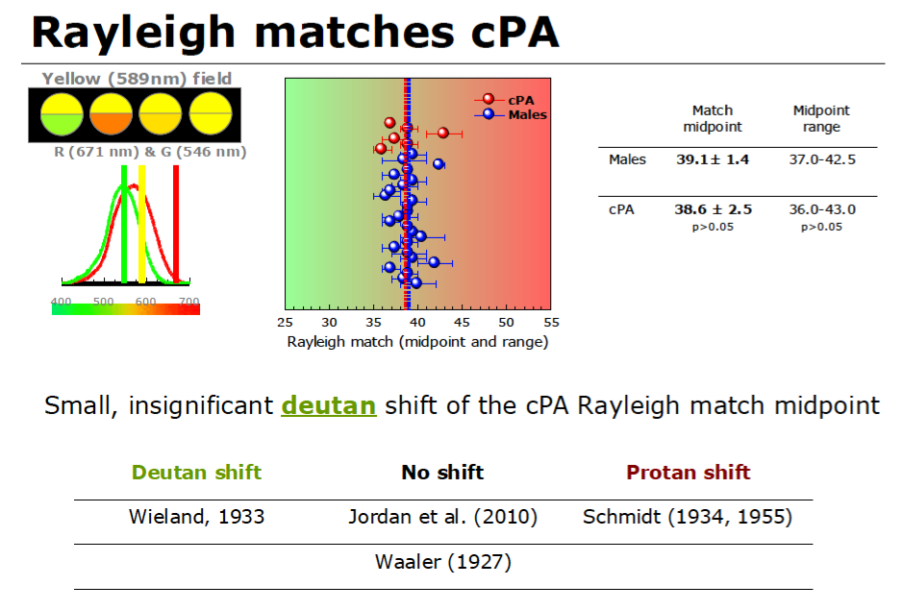

Slide 15




K.I.S.S.
STICK TO SIMPLE FONTS AND PALETTE
Don’t centre the text or use a serif typeface
TOO MANY BLOCK CAPS CAN BE DIFFICULT TO READ

Slide 16
Presentation Guideline
If you would like further advice, help or suggestions on layout and design of an effective presentation, and on how to present your work, please contact
info@colour.org.uk
who will pleased to help

